Slide 1
GANs: A Primer

Slide 2
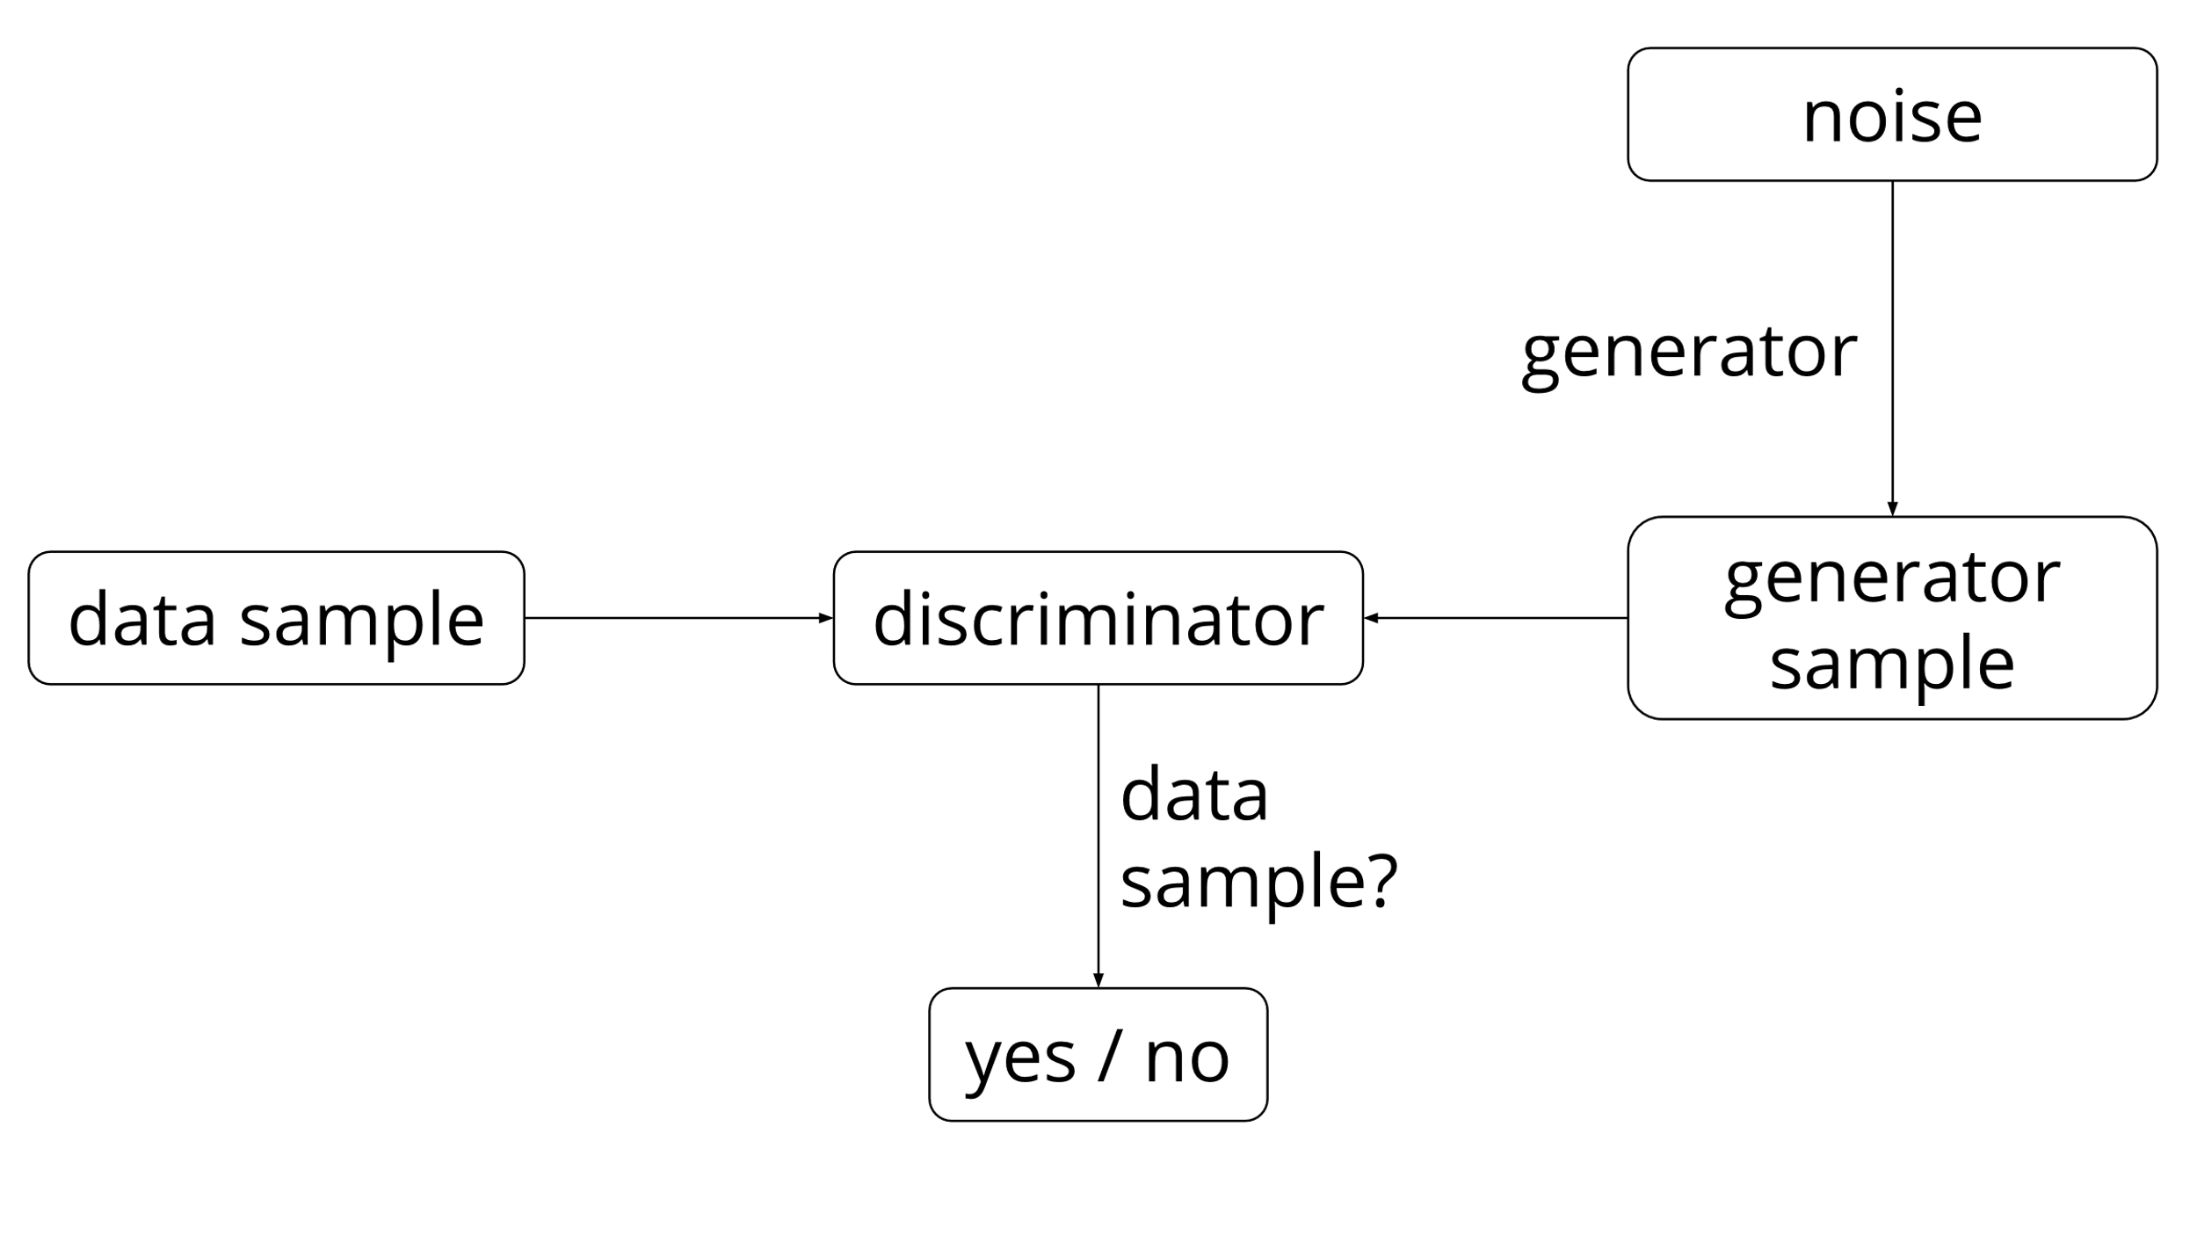
What are GANs?
The Goal is to model an unknown probability distribution.
This is set up as a competition between two Neural Nets, a Generator (G) and a Discriminator (D).
Trained at the same time.
Both the G and D are updated based on the results of D.
https://ishmaelbelghazi.github.io/ALI/

Slide 3
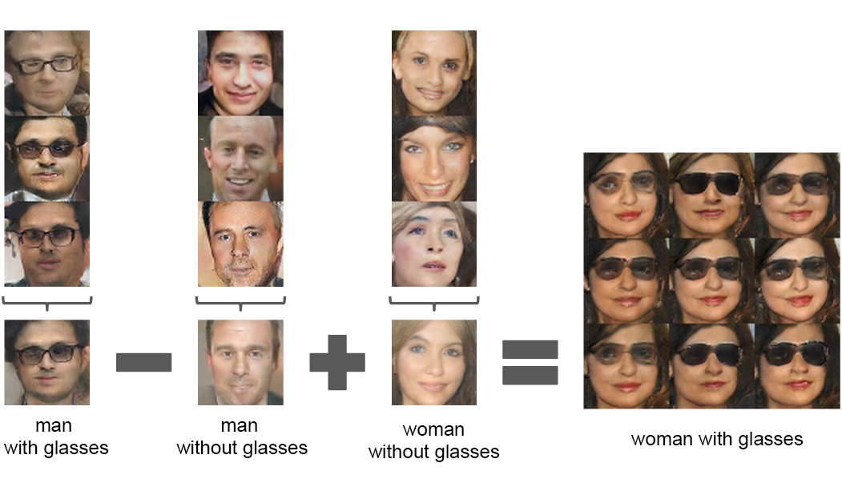
Potential Uses: General Comms
Some Current Uses
Potential Uses in Comms
Most current uses are in the Computer Vision Context
Generating training data.
Semantic arithmetic.
Adaptive channel modelling.
Signal Detection.
Single user isolation??/modScheme/

Slide 4
Potential Uses: SCaN
Still trying to work this out.
Could make sense in the explore network.
Offline training
Cons: Requires large amount of training data to become a useful model.

